Slide 1
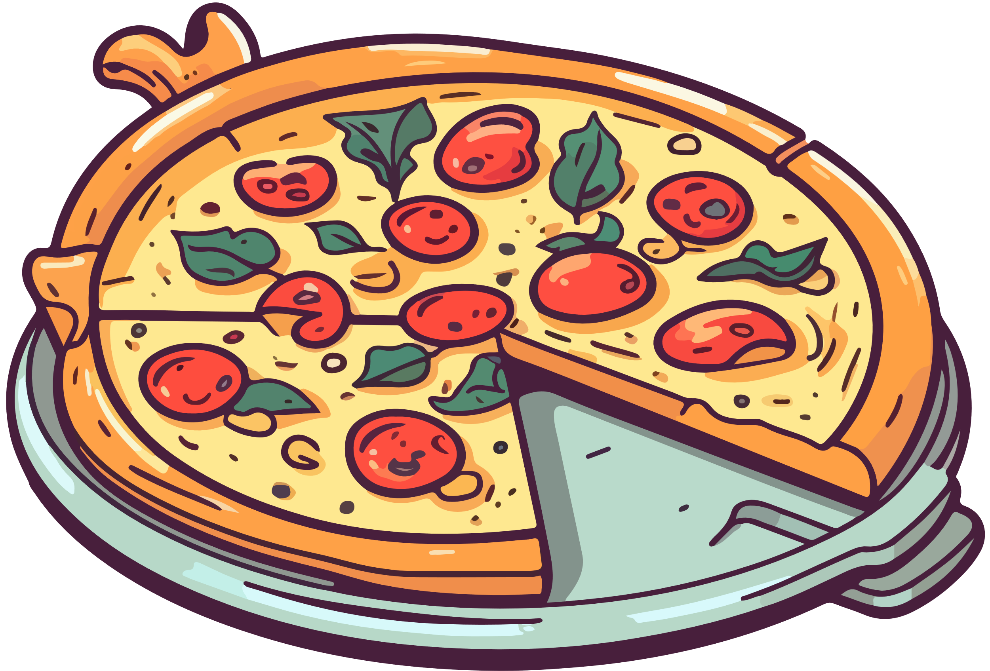

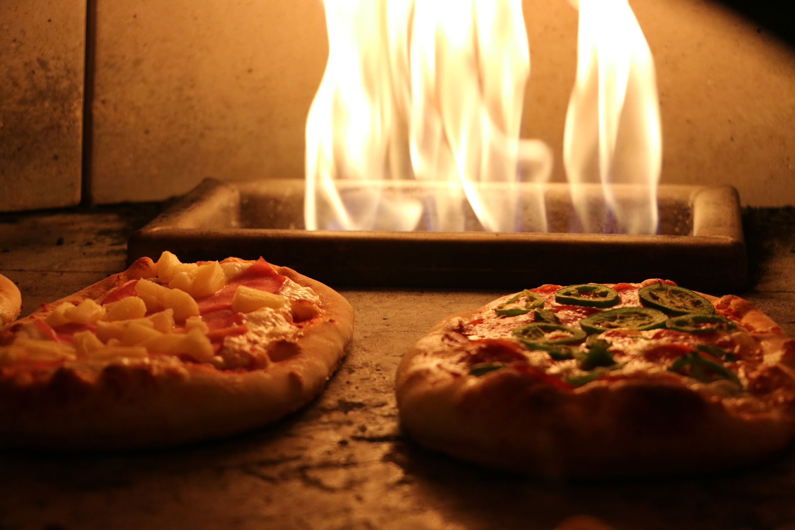
PIZZA SALES ANALYSIS
by : Vipin Karunakaran
Tool :- POWER BI

Slide 2
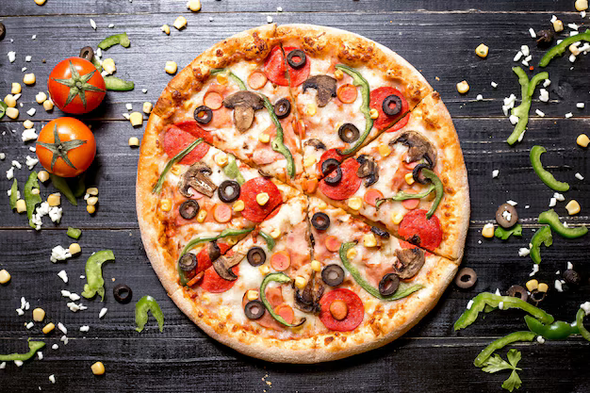
INTRODUCTION
Pizza sales analysis involves examining sales data to identify trends, customer preferences, and performance metrics. This helps businesses optimize their offerings, improve customer satisfaction, and increase overall profitability.

Slide 3
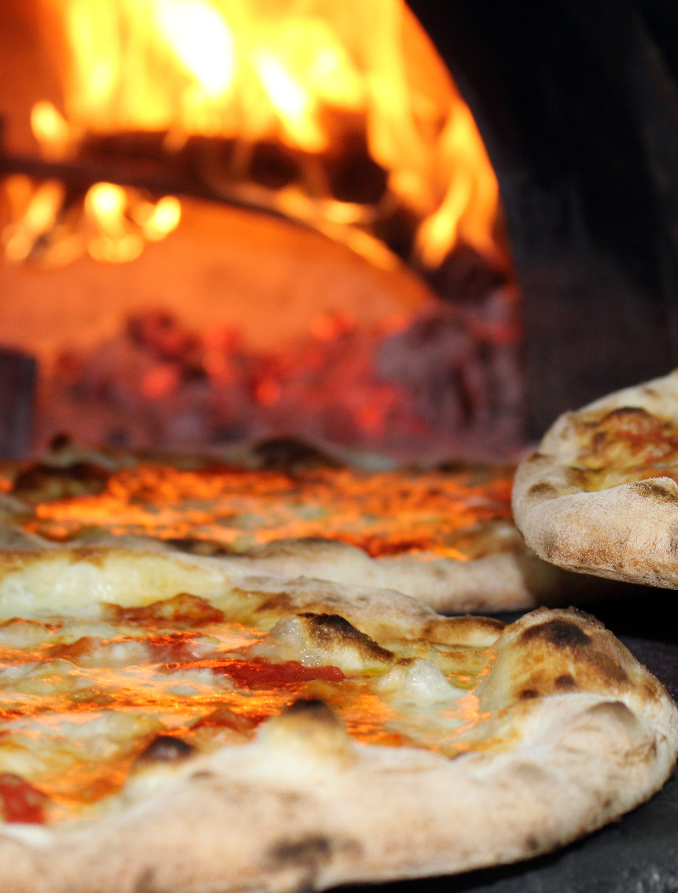
BUSINESS TASKS
Find the KPI’S?
What is our monthly Revenue performance?
What days and times do we tend to be busiest?
Find the Revenue generated by Pizza Category,Which category is most in demand?
What is the order performance of our various pizza sizes?
What are our best and worst-selling pizzas?
What's our average Revenue?

Slide 4
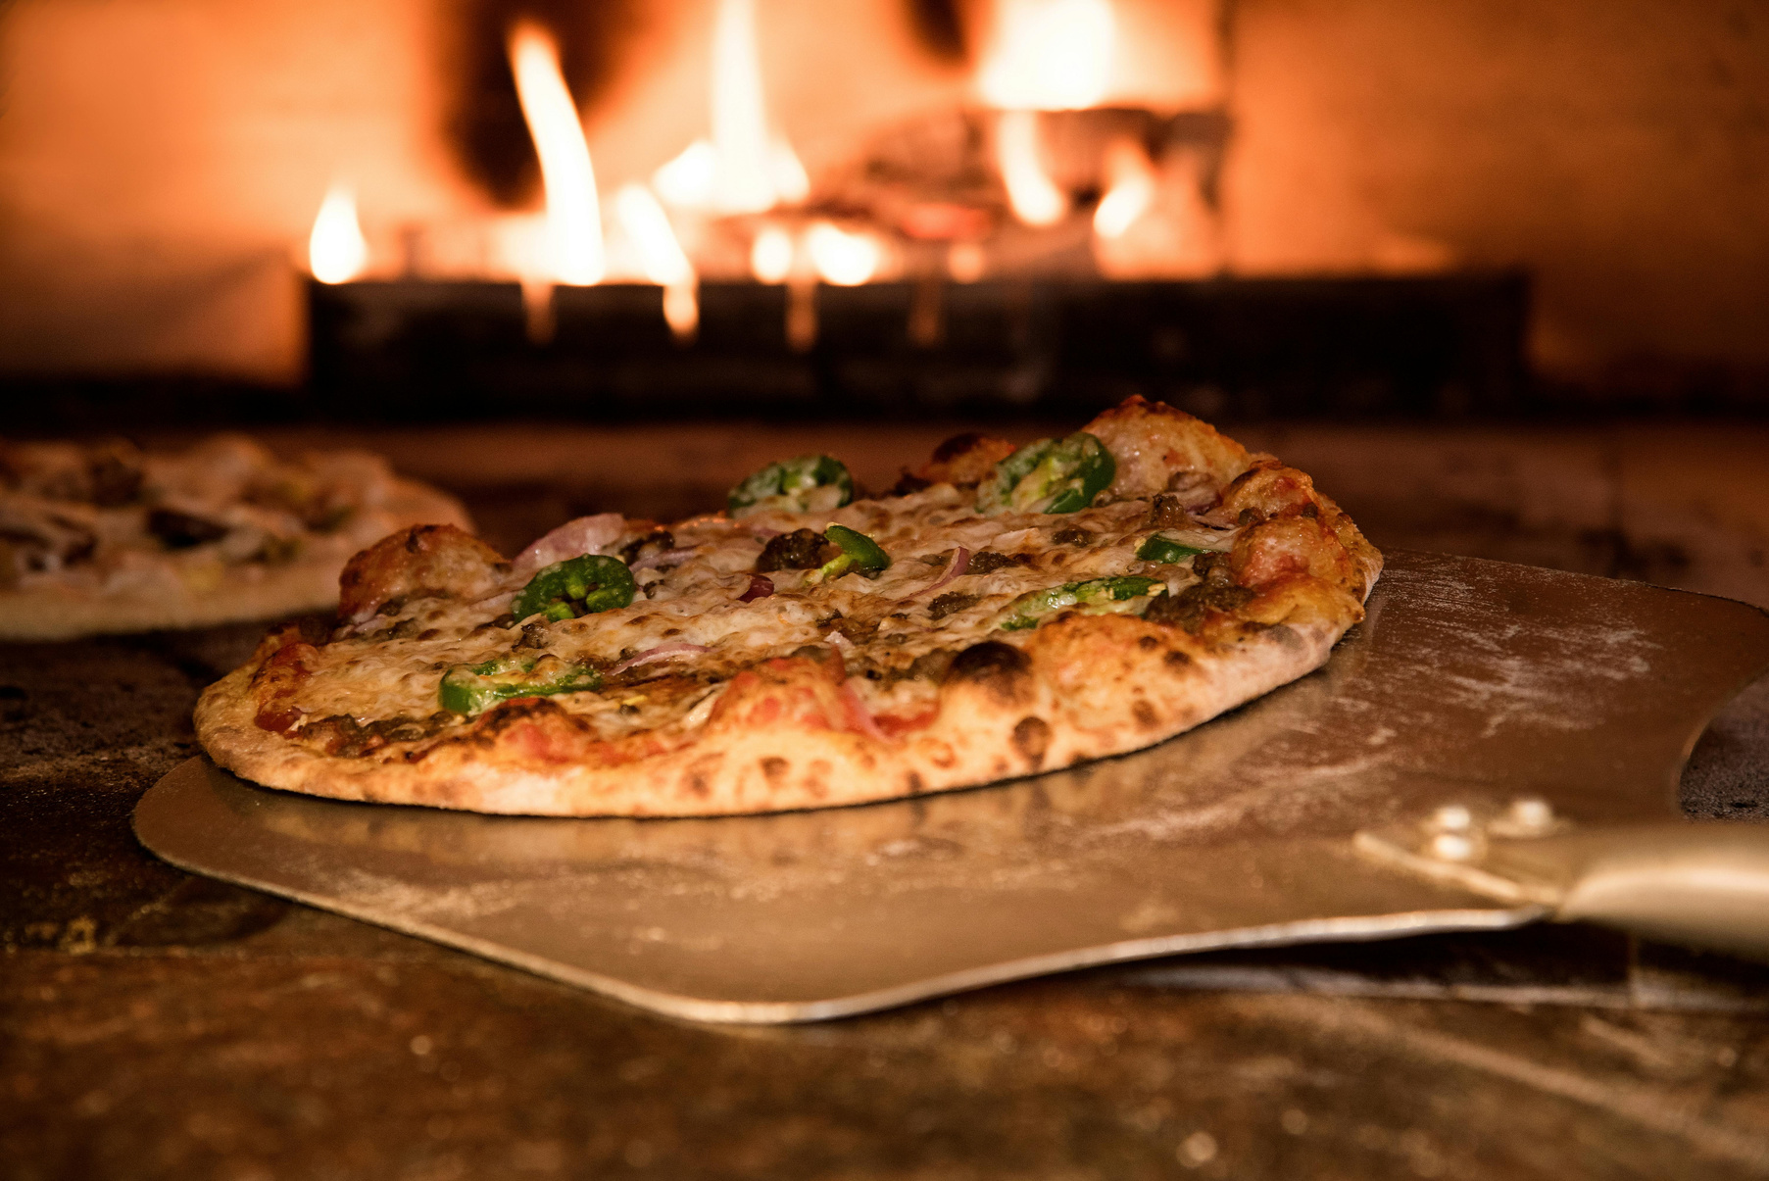
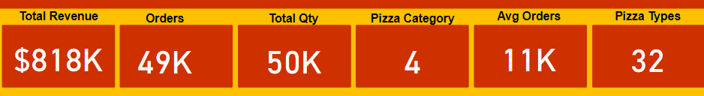
KPI’S REQUIREMENT
We need to analyze key indicators for our pizza sales data to gain insights into our busniess performance , following metrics are :
1.Total Revenue : Sum of all Revenue Generated
2.Total Orders : Total number of order placed
3.Total Quantity : Sum of the quantity of all pizza sold
4.Pizza Categories :Number of Pizza Categories
5.Average Orders : Average amount spend per orders
6.Pizza Types : Number of Pizza types

Slide 5
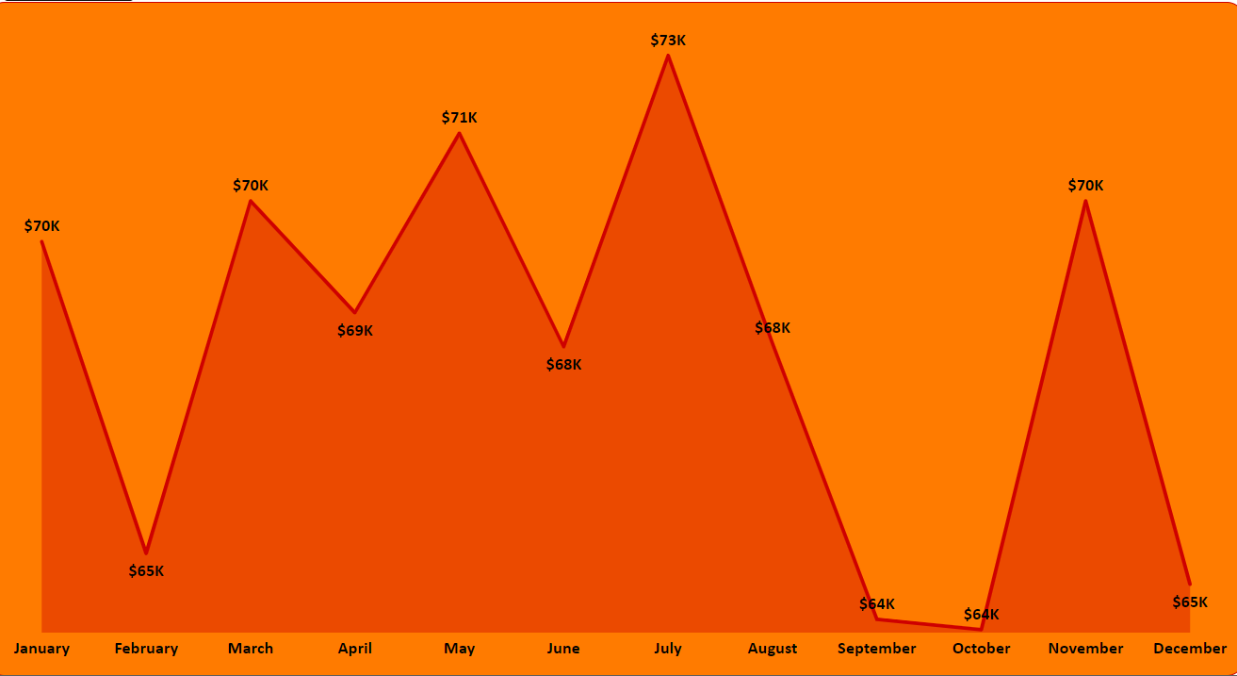
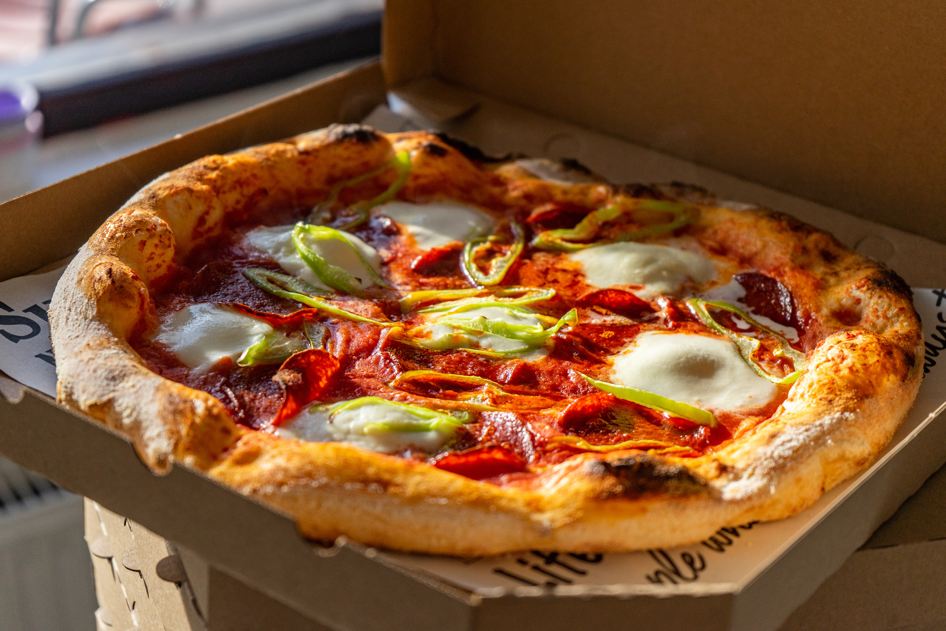
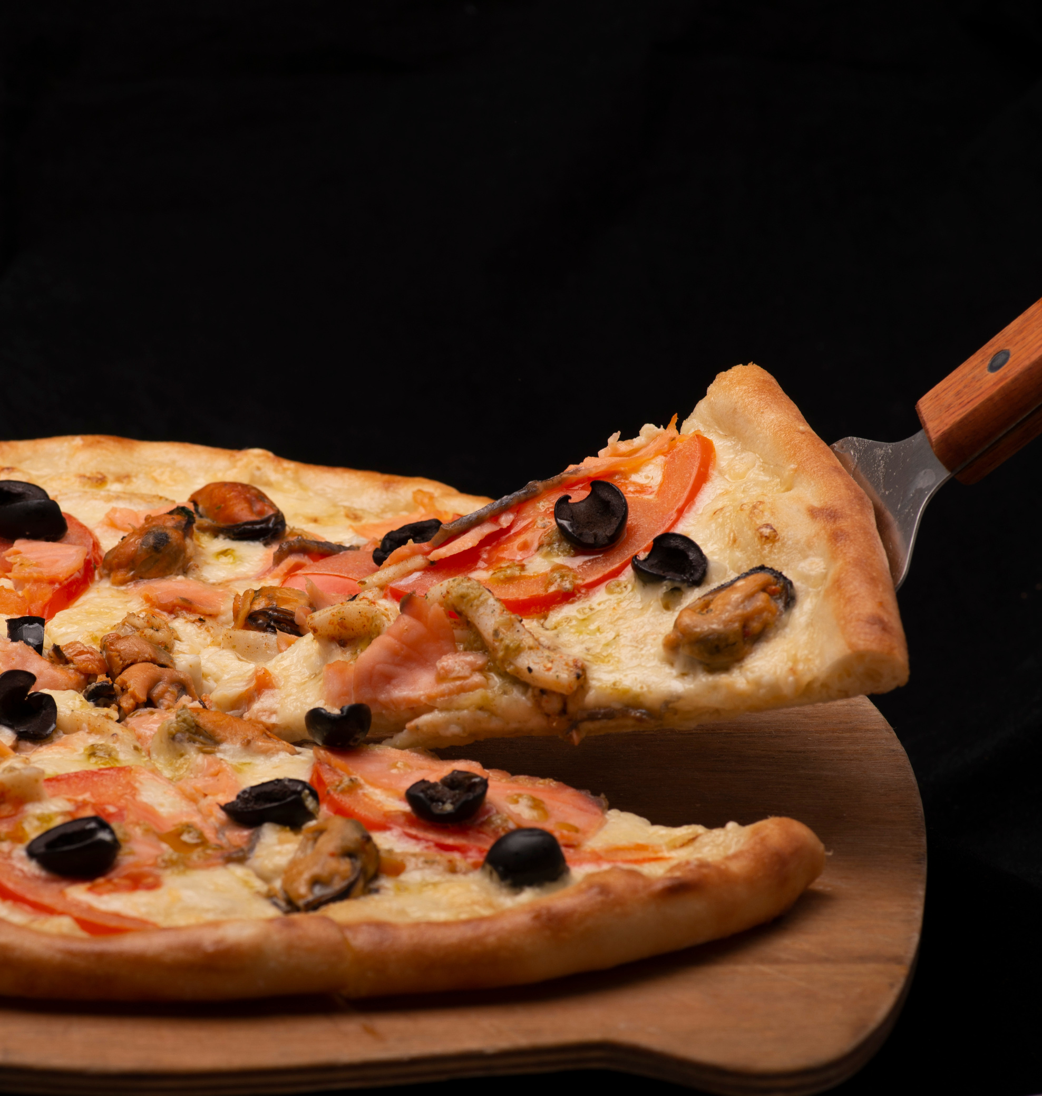
REVENUE BY MONTH
July was the top-performing month for pizza sales, with $73k in revenue. September and October were the least performing months, each generating $64k. This trend shows a strong summer performance followed by a decline in early fall, possibly due to seasonal factors.

Slide 6
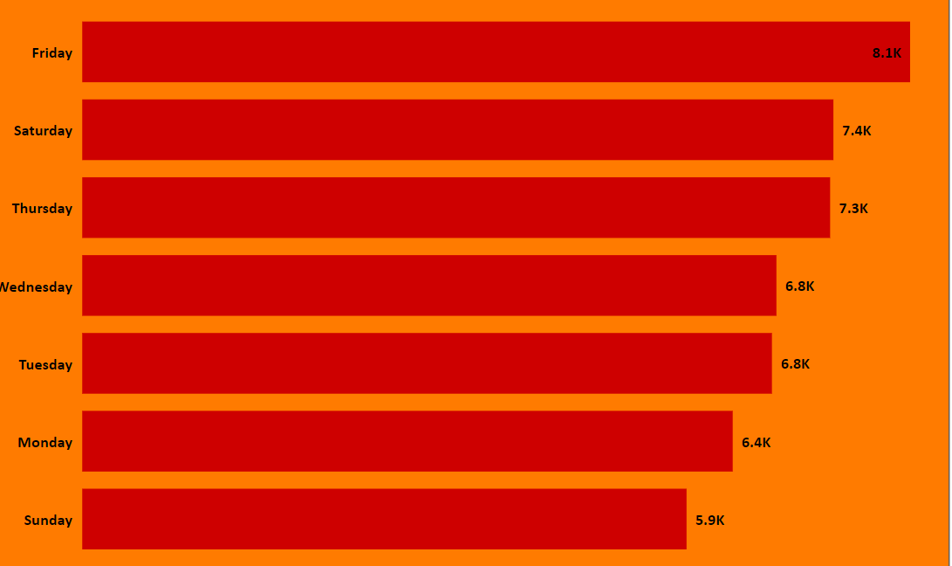
ORDER BY WEEKDAYS
The highest pizza orders are secured on Friday and Saturday, totaling $8k, while Sunday records the lowest, below $6k. This trend highlights a peak in weekend demand at the start, tapering off by Sunday, indicating a shift in consumer behavior as the weekend progresses.

Slide 7
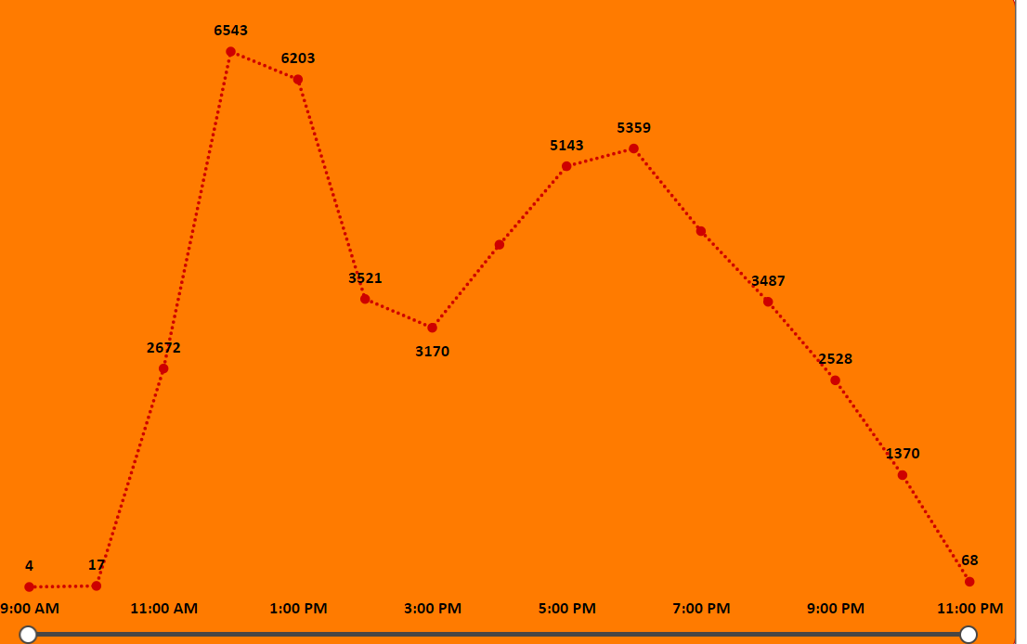
ORDER BY TIME
The busiest time of the day is between 12 PM to 1 PM due to lunch, generating around 6,400 orders. After 7 PM, the number of orders decreases significantly, with the least activity occurring at 11 PM, showing only 65 orders. This highlights the peak and off-peak hours for orders.

Slide 8
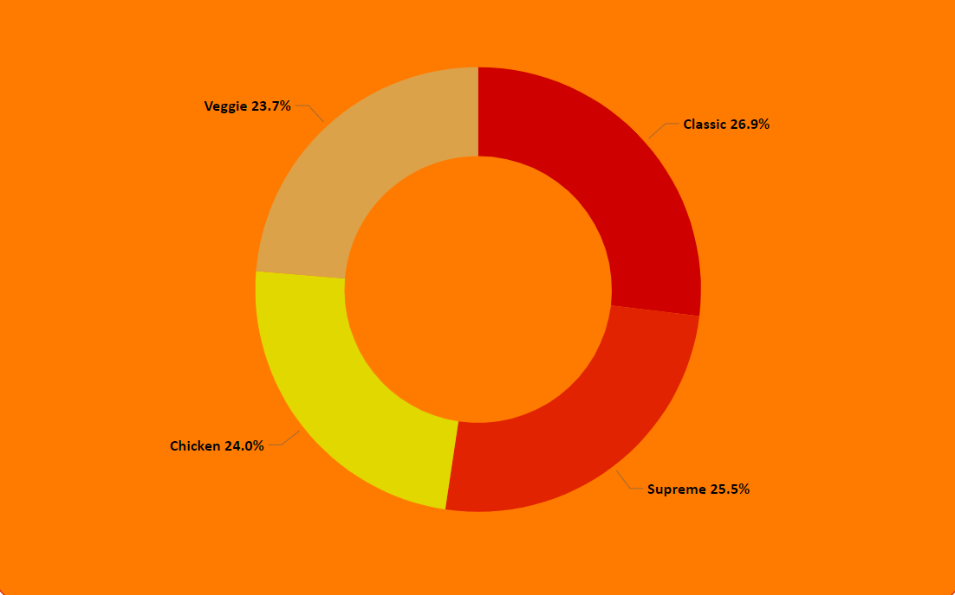
REVENUE BY PIZZA CATEGORY
The Classic pizza category leads with nearly 27% of total revenue due to high demand, followed by Supreme and Chicken pizzas, reflecting strong consumer preferences in these categories.

Slide 9
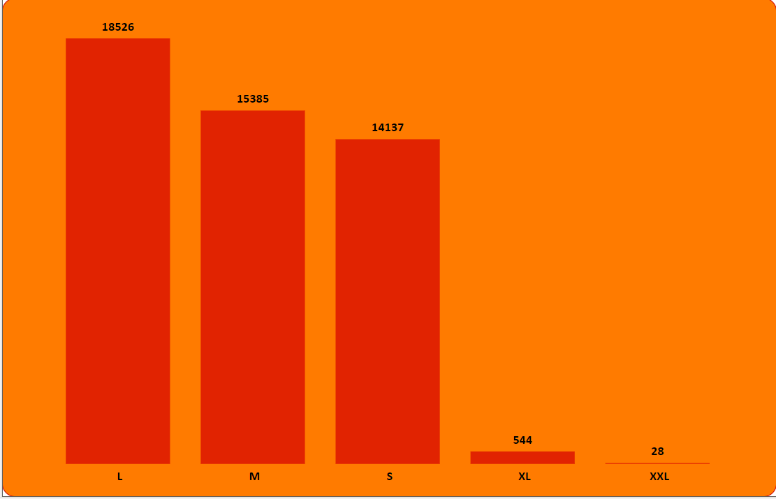
ORDER BY PIZZA SIZE
The large size pizza dominated orders with 18,526, while XL and XXL sizes had minimal demand, securing only 30-45 orders each. This suggests a strong preference for large pizzas.

Slide 10
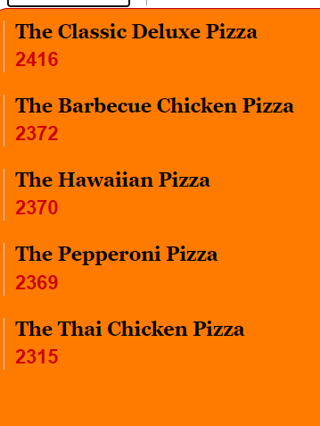
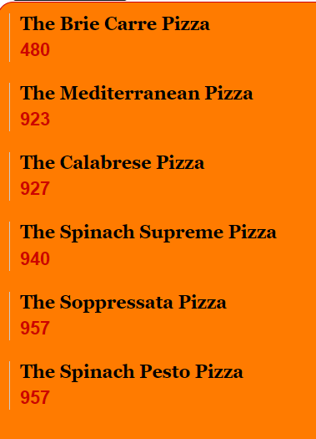
TOP AND BOTTOM SELLING PIZZA’S
The Classic Deluxe Pizza tops the sales charts with 2,416 orders, making it the most popular choice. Close behind is the Barbecue Chicken Pizza with 2,372 orders. In stark contrast, The Brie Carre Pizza struggles, receiving only 480 orders, marking it as the least favored option among customers.

Slide 11
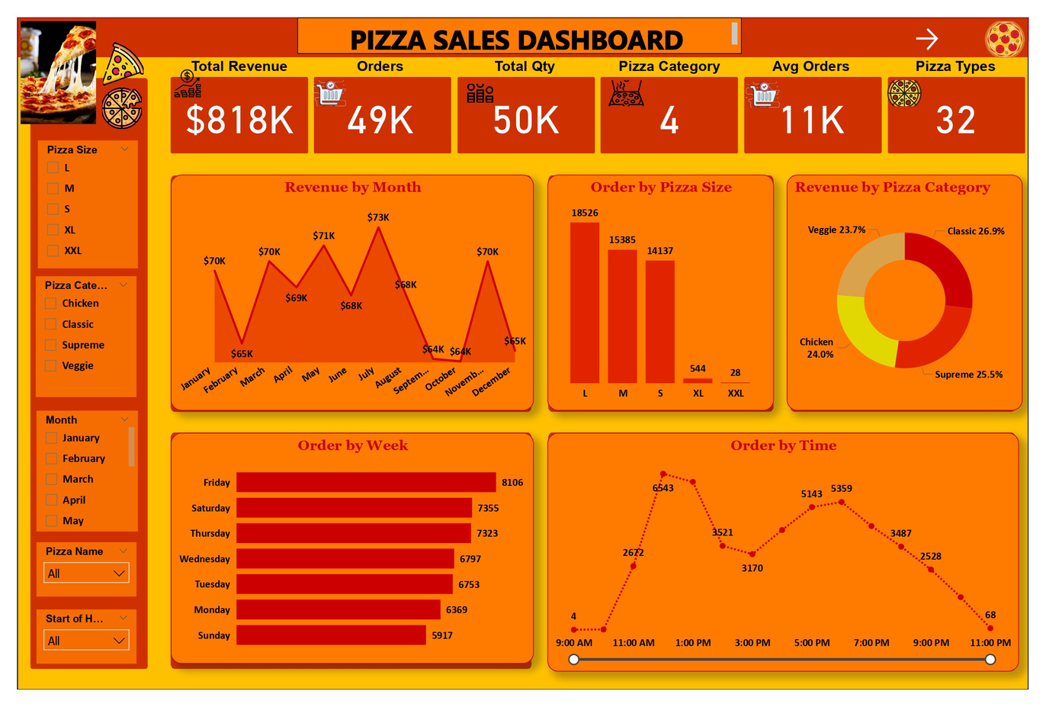
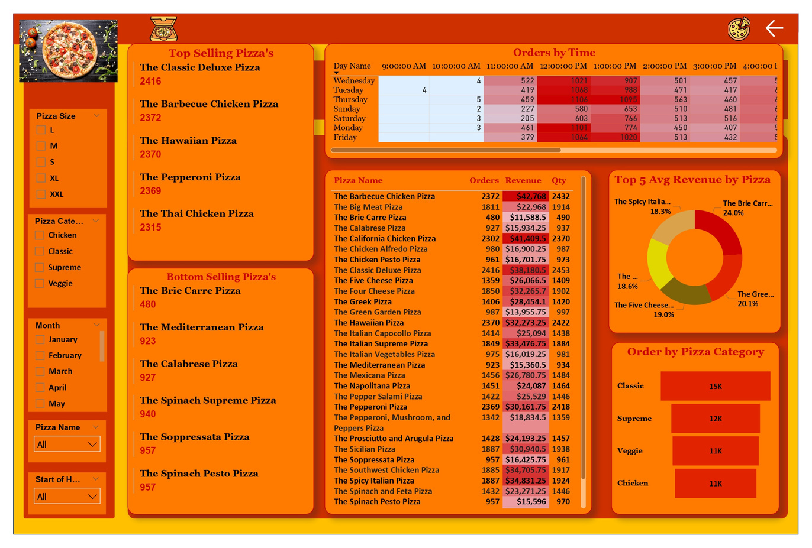
DASHBOARD OVERVIEW

Slide 12
CONCLUSION
Pizza orders rise from Sunday, peaking on Friday, indicating a weekend preference. Most customers choose Pepperoni pizza for Friday lunch. To meet demand, ensure ample seating and consider delivery services. Stock up on Pepperoni ingredients by Friday, and introduce a "Buy 3, Get 1 Free" discount every last Friday to boost sales.

Slide 13

THANK YOU

